Slide 1

Toy Sales
Mollie ZHU

Slide 2
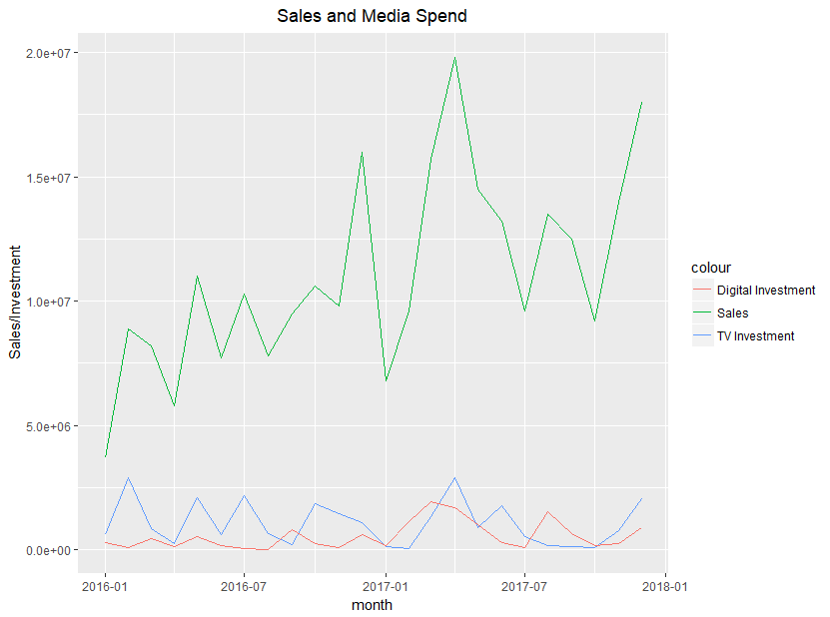
Sales vs Media Spend
Correlation | Sales
TV | 0.441
Digital | 0.665
Notes:
Digital spend has higher correlation because increasing spend in 2017 when sales boosted.

Slide 3
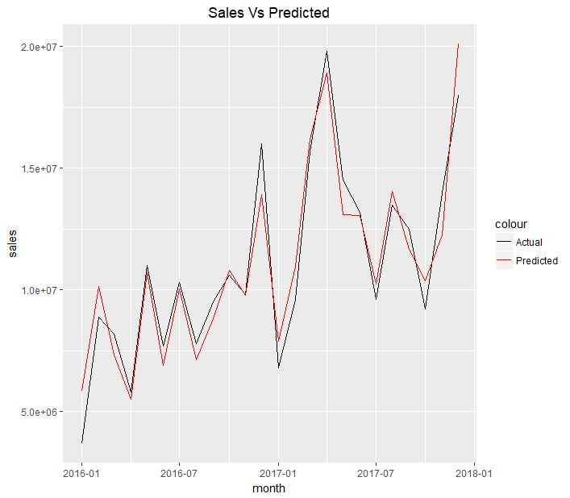
Quick Model
Adjusted R-Square = 0.8984
Base sales is $3,451,045 and it is significant
TV and digital variables are significant
Trend is also significant
Xmas is not significantly affecting sales
 | Estimate | Std. Error | t value | Pr(>|t|)
Intercept | 3,451,045 | 670586.7000 | 5.1463 | 5.74E-05
TV | 2.0265 | 0.3071 | 6.5990 | 2.58E-06
Digital | 2.9827 | 0.5040 | 5.9186 | 1.07E-05
trend | 286,287.1 | 41564.6000 | 6.8878 | 1.44E-06
Xmas | 2,934,647 | 973021.2000 | 3.0160 | 7.11E-03
Notes:
Trend will be less significant once carry over effect and other data are used in the model.

Slide 4
TV
Total TV spend in last two years were $25,473,374.
TV has contributed 19.43% of total sales in the last two years.
Total sales driven by TV were $51,622,803.
Return on investment for TV was 2.03.

Slide 5
Prediction based on simple model
Assume the increasing trend of sales has stopped in 2018
Month | TV | Digital | Predicted Sales
Jan-18 | 350,000 | 215,000 | 11,672,508
Feb-18 | 950,000 | 150,000 | 12,694,555
Mar-18 | 1,350,000 | 400,000 | 14,250,850

Slide 6
Further…
Above model shows 34.3% sales in last two years were contributed by media. It is a very large proportion for toy industry which indicates more variables shall be considered. Such as
Promotions. April 2017 had huge increase in sales which wasn’t seen in 2016. Model has considered it was driven by media because both TV and digital had increased spend in that time. I would say model is over-predicted, there was something happened.
Average price.
Number of stores.
Birth rate by month. People tend to shop for toys as a gift for a newborn.
School holidays. Kids have more exposure to toy shops during this time.
Competitors media spend.
TV TARPs and online impressions. Spend is not true Ad exposure.
Media diminishing return and carry over effect need to be considered in the model
A model has been built with above consideration. Trend significance has been brought down and TV ROI has increased.
Estimation for April 2017 is lower than actual which suggests simple model was over-predicted.
Notes:
Because there was no other variables, TV has been rated too high saying contributed 47% of sales. I won’t explore more with transformation because data is not enough.
Average price and promotion may have multicollinearity.
What does this trend represent? Once more variables are tested maybe trend can be replaced (explained).

